Slide 1


HOME
BUYERS
GUIDE

Slide 2


IN MY EXPERIENCE…
what makes a dream home is different for everyone, it’s personal to you…
It's about how you feel when you walk through the front door.
This is about more than real estate - it‘s about your life, your dreams and your desired outcomes. Working with home buyers is not a one-size ﬁts all process, so I approach each one of my clients individually, taking the time to understand their current situation, unique needs and lifestyle. I understand I am helping my clients open a new chapter of their lives, which is why I work so diligently to ﬁnd the perfect home and handle every last detail of the home buying process.
I am honored to guide you through this process and excited to help you ﬁnd that perfect home!

Slide 3
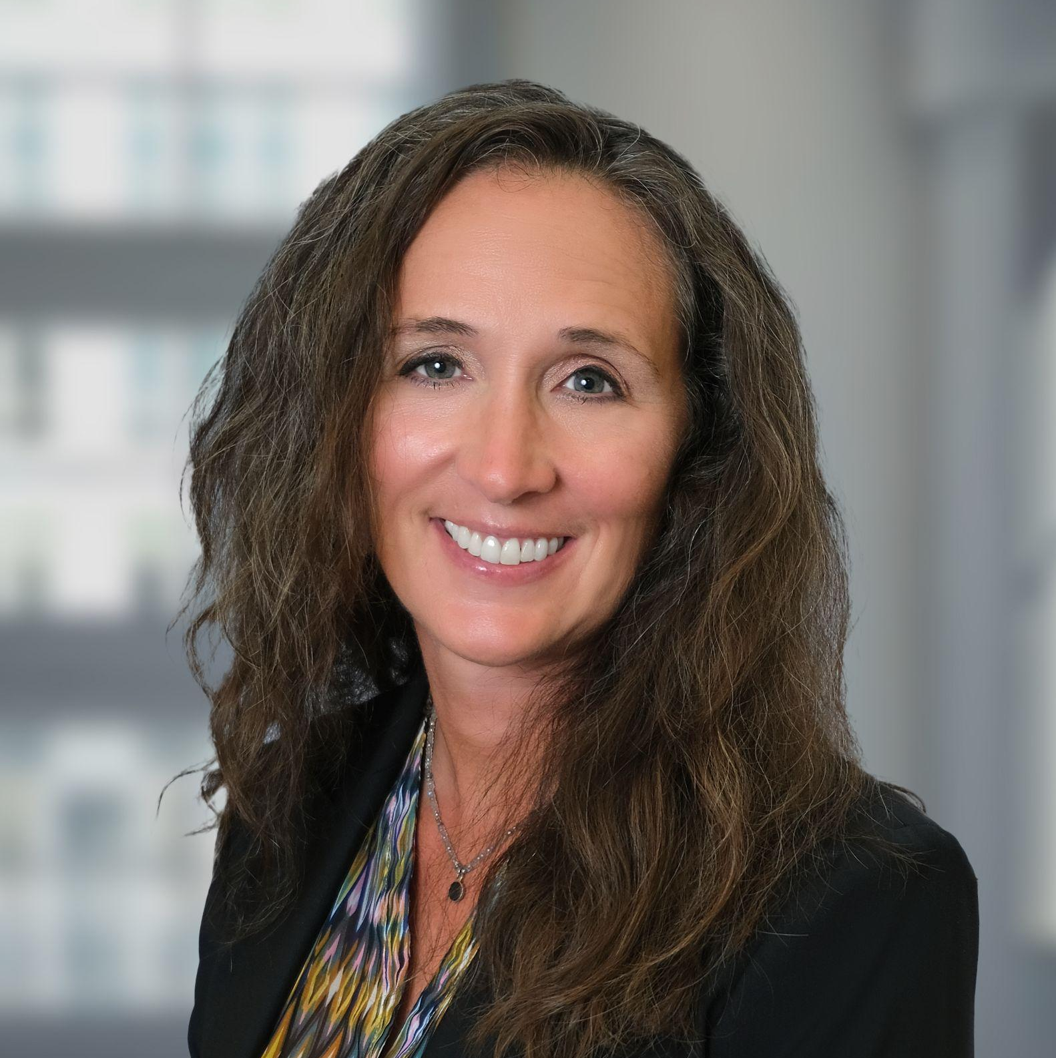



Meet The Agent:
Christy Willard
Hello! I’m Christy Willard and I’m thrilled to have the opportunity to partner with you!
I will use my professional skills and hard work to guide you through your home buying or selling experience. My pledge is to listen to you as we work side by side to create the best environment for a fantastic outcome.
A little about me… I fell in love with Real Estate a little over a decade ago when I became a registered appraiser. At that time, I decided to pursue my college degree and received my Associates in Business Management. I’ll bring my researching and negotiating skills to bear as I search out properties that are just right for you! I’ll use the most cutting edge technology to search out properties and keep you in the loop. I’ll make sure that we get the best deal possible with my skills as a communicator and negotiator, always checking in with you. I also have access to fantastic professionals in every area of real estate including trustworthy and experienced mortgage brokers, inspectors and contractors-most of whom I’ve done business with myself-so I know they’re great! I also bring you value with an army of incredible agents beside me at the Keller Williams Signature Partners Office and Heart of Atlanta Group, so if I don’t have an answer for you, I will definitely go to any length to find it for you.
If you need to sell a property, I developed skills in my investment company that can help you get the best price for your home. I learned the ins and outs of the valuation of property through market research so that a home will be competitively priced-but not so high that it won’t find a buyer. When I was selling my own properties, time and money were always first in my mind. I learned how to get the best prices in the least amount of time, giving me the best profit. Now I’m committed to doing the same thing for my clients. Professional photography and intensive multi-media marketing will expose your home to thousands of potential buyers. I’ll also make use of my personal connections, Keller Williams Signature Partners private social media, and my affiliation with the largest real estate firm in the state, the Heart of Atlanta Group, to expose your property to hundreds of real estate professionals who will be on the lookout for our buyer as well.
I’ve had the privilege of working alongside some of the most successful agents in the nation. Their expertise has shaped my approach to real estate, and I’m proud to bring that same level of commitment, knowledge, and customer service to every client I work with.
So why choose me? You would be hard pressed to find a more dedicated, energetic, or focused agent to represent you. Please give me a call for a no obligation assessment of your needs!
Let’s get started on this exciting journey!
Christy Willard
REALTOR®
c: (770) 833 -7359
o: (678) 631-1700
christywillardr@kw.com
https://chistywillard.kw.com

Slide 4


















THE HOME BUYING PROCESS
Select a Realtor
Obtain Financial
Pre Approval
Analyze Your Needs In
A Buyer Consultation
Select Properties
View Properties
Write An Offer To Purchase
Negotiate Terms
Accept The Contract
REMOVE CONTINGENCIES
Conduct Title Search
Conduct Inspections
OBTAIN MORTGAGE FINANCING
Remove Any
Encumbrances
Resolve Any Issues
CREDIT CHECK
UNDERWRITING
APPRAISAL
SURVEY
INSURANCE
Obtain Title Insurance
Obtain Funds for Closing
Close on the Property
Take Possession of Home!

Slide 5

WHY KELLER WILLIAMS
TEAMWORK
Keller Williams Realty was designed to reward agents for working together. Based on the belief that we are all more successful if we strive toward a common goal rather than our individual
interests, I’m conﬁdent that every Keller Williams professional shares the common goal of serving you, my client, in the best way possible.
KNOWLEDGE
Keller Williams Realty helps me stay ahead of trends in the real estate industry through its comprehensive, industry-leading training curriculum and research resources. It’s what prepares me to provide you with unparalleled service.
RELIABILITY
Founded on the principles of trust and honesty, Keller Williams Realty emphasizes the importance of having the integrity to do the right thing, always putting the needs of the client ﬁrst. It reinforces my personal belief that my success is ultimately determined by the way that I serve each client and the legacy I leave with each client I serve.
TRACK RECORD
I’m proud to work with the largest real estate franchise in the World by agent count. It’s proof that when you offer a superior level service, the word spreads fast.

Slide 6
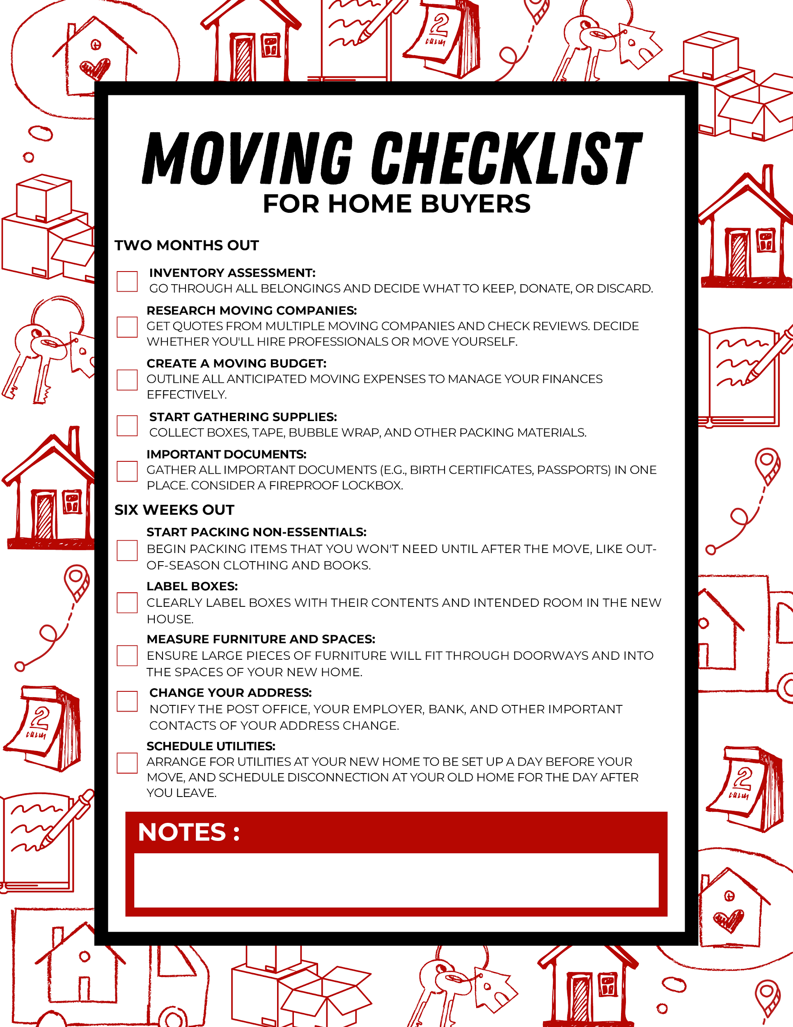

Slide 7
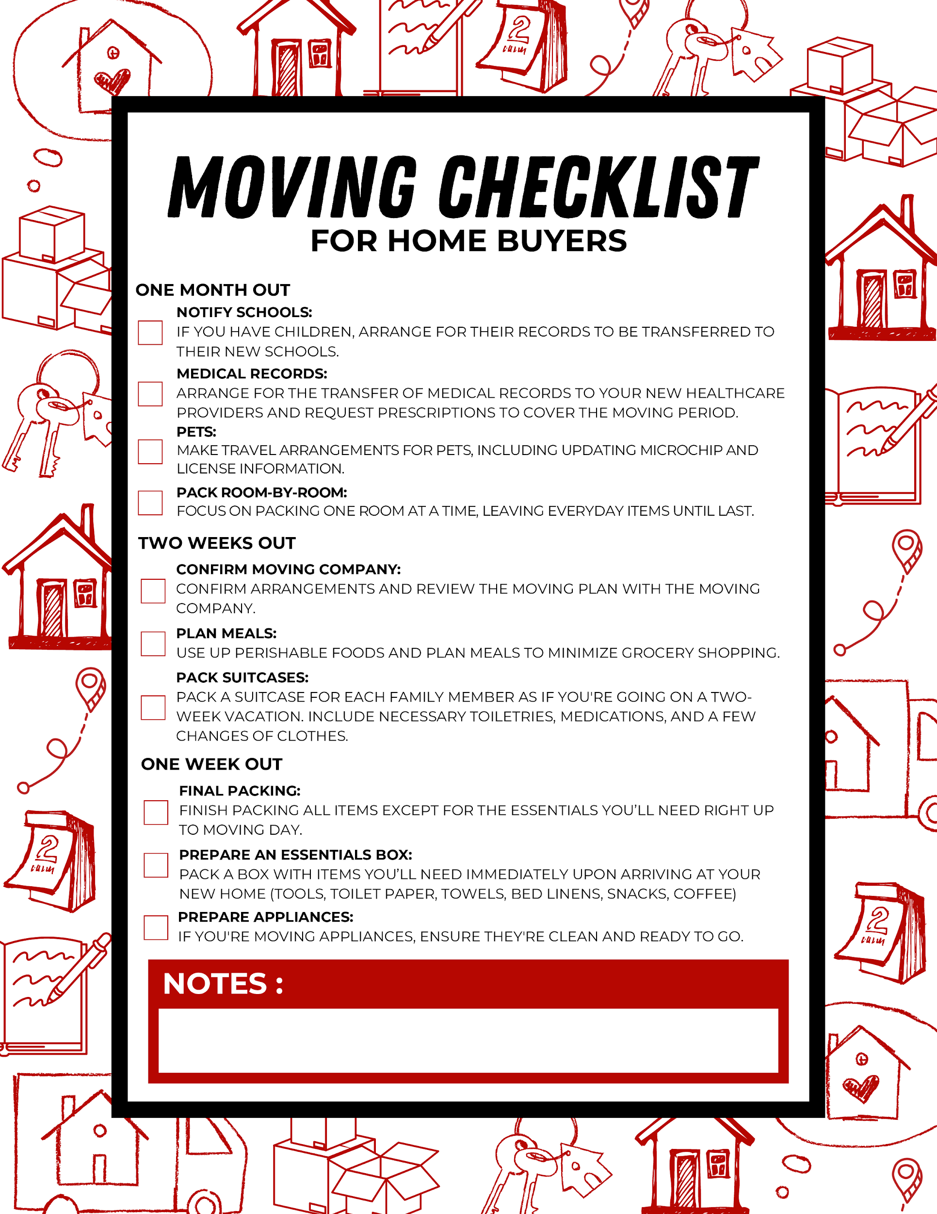

Slide 8
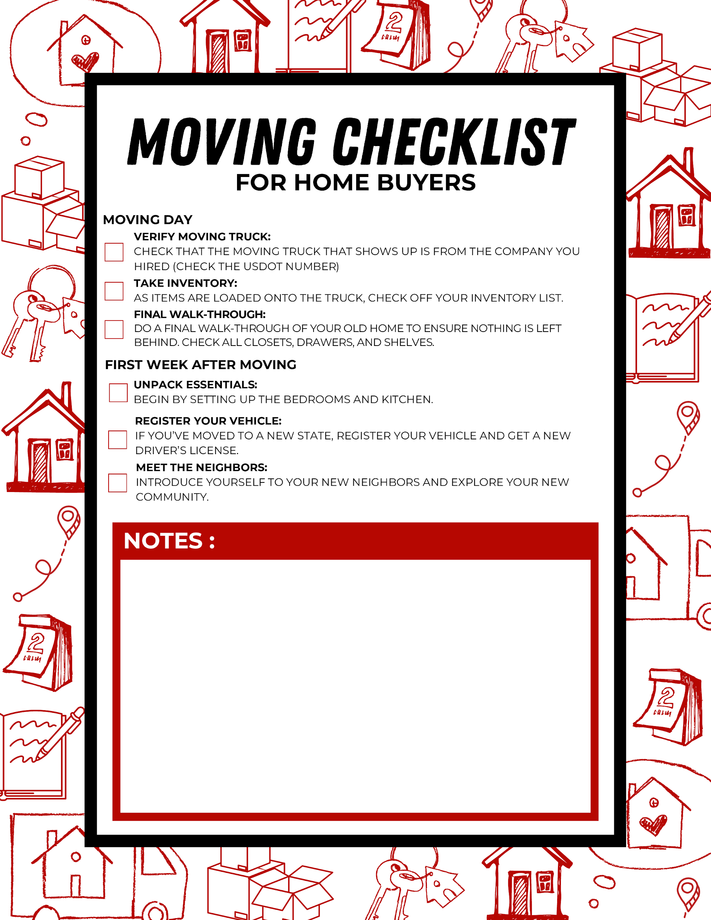

Slide 9
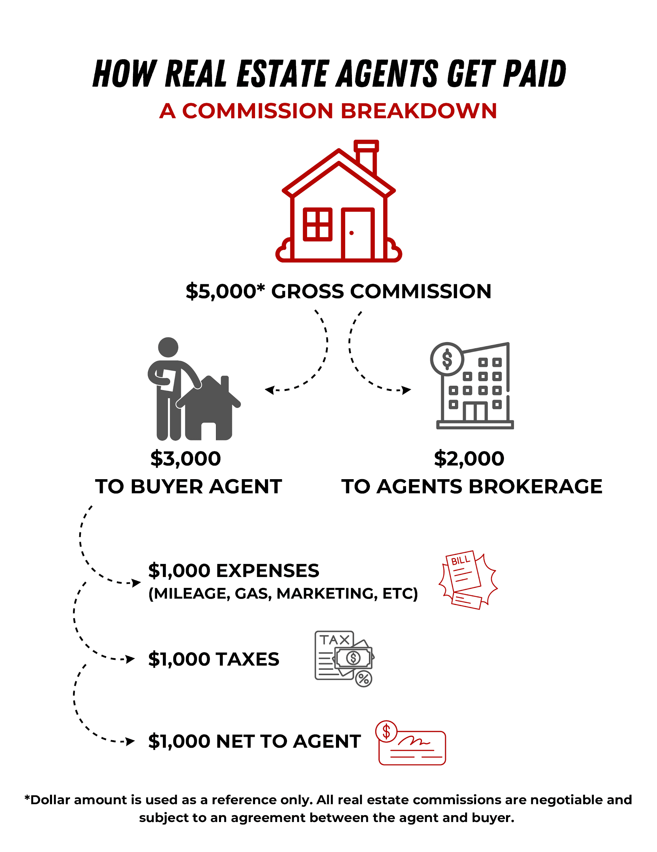

Slide 10


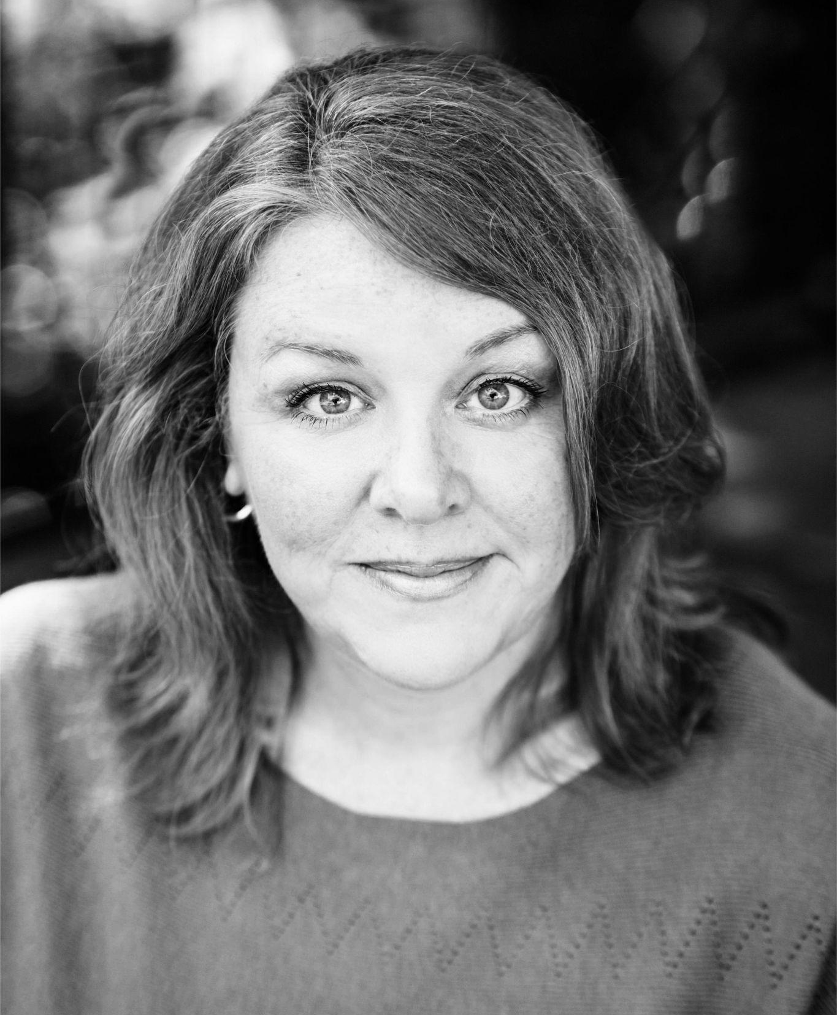

It’s what I love to do and I can’t wait to with get started with you!
Becky Hammer
REALTOR® License #444894
404-786-3995
email: rebekahhammer@kw.com
Each Office is Independently Owned and Operated

